Slide 1
Establishing ACT-based Training Programs at Military Organizations for Building Operational Readiness
LCDR Christopher Udell, PhD, ABPP
Clinical Psychologist
Officer in Charge, Combat Stress Platoon
Marine Embedded Psychology Subspecialty Leader
3d Medical Battalion, 3d Marine Logistics Group
Okinawa, Japan

Slide 2
Relationship between mental health providers and military leaders
No known involvement of military psychiatrists in wars prior to WWI, but Napoleon Bonaparte’s physicians instructed emotionally drained troops to remain with units while taking time out for rest, exercise, and musical entertainment¹
WWI, neurologist Georges Guillain’s efforts to evaluate and treat French Army combat stress casualties as close to the battlefront as possible
British Army psychiatrist C.S. Meyers and the American physician Thomas Salmon followed his lead
This approach to providing brief treatments close to the front lines became the PIES model (by U.S. Army psychiatrist Kenneth Artiss)² and has been a foundation to U.S. military operational mental health in conflicts and exercises ever since

Slide 3
PIES Model
Proximity
Treating troops as close to the front lines as possible; also refers to 1) keeping troops within their units while they are receiving evaluations and treatment, and 2) keeping mental health officers and technicians within the units they are serving (also called Embedded Mental Health)
Immediacy
Refers to the importance of initiating care as quickly as possible
Expectancy
Refers to the expectation that the unit member will be able to recover in the shortest time possible and return to duty; if member does not respond to treatment or cannot continue with current duties, member may have to be moved out of the unit or given different duties
Simplicity
Refers to preference for brief psychological treatment interventions
* In 1999, Department of Defense replaced the PIES model with the BICEPS model (DOD Directive 6490.5; Brevity, Immediacy, Centrality, Expectancy, Proximity, Simplicity)

Slide 4
Relationship between mental health providers and military leaders (cont.)
Sometimes conflicted, sometimes confusing relationship
Distrust and misunderstandings
Wizards
“Can’t you just fix her?”
”What’s the problem with him staying hospitalized?”
How do mental health providers satisfy both the member and the command? Not always possible
What does the commanding officer expect? What will benefit the unit the most and support the mission? What will build operational readiness of the unit?

Slide 5
Relationship between mental health providers and military leaders (cont.)
What mental health officer sees
“This Marine is a danger to himself and has maladaptive personality traits that hurt unit cohesion. Recommend separation.”
“I would like to begin running an evidence-based treatment group for increasing psychological resilience in your battalion.”
What command leadership sees
“Yes, agree that separation is necessary.” or “No, we need someone with that specialty.” “No, he seems to be doing fine in the shop. Keep him.”
“Okay. What will it do for my Marines and Sailors? Will it make them handle stress and pressure better? Will it prevent more suicide attempts and alcoholic incidents? Is it going to take too much time and pull them out of their duty obligations?"

Slide 6
What are you bringing to the command and how does it benefit them?
Buy-in from the command leadership is necessary for any program to have a chance of success
Buy-in requires a ‘sales job’ so to speak; what are you offering that fits with the needs of the command
Must be careful not to come across as a too academic or fall into ‘mental health speak’; make your message straightforward and couched in operational language
However, you are the mental health expert, and it is your job to educate the command leadership on what is needed and what is realistically accomplishable

Slide 7
Issues military commands are facing
Trends in society toward greater insecurity, self-victimization, over-reliance on emotions in decision-making, resistance to adversity, and frequent self-destructive behavior^{3,4}
Challenge of recruiting and maintaining credible forces to defend national interests at a time when the availability of qualified personnel is growing thinner^{5,6,7}
Relaxation of enlistment standards^{8,9}

Slide 8
Issues military commands are facing (cont.)
Dynamic shifts in the way wars are and will be fought (e.g., cyber, space)
Near-peer competitors in China and Russia
Doing more with less—a common theme within the U.S. military, but now more than ever as service branches further streamline; some specialty occupations added or increased, others eliminated or reduced

Slide 9
Development and implementation of two ACT-based programs: one for Navy, one for Marine Corps
Mindfulness for Pain and Performance Enhancement (MPPE)
3d Marine Logistics Group (3d MLG)-wide Psychological Resilience Program

Slide 10
Mindfulness for Pain and Performance Enhancement (MPPE)

Slide 11
Naval Recruit Training Command at Great Lakes, IL
8-week long training for all enlisted personnel entering the U.S. Navy; graduation is contingent on successfully completing a Physical Fitness Assessment (PFA) consisting of a 1.5 mile run, curl-ups, and push-ups
Recruits who are injured during training (e.g., stress fractures, dislocations, sprains, etc.) are pulled from training and receive standard physical therapy and other medical treatments
As of 2014, 50-60% of these recruits were discharged from the RTC for failing to either recover or not successfully complete the PFA upon getting medically cleared back to training

Slide 12
What can ACT do for your command?
Great Lakes RTC wanted to reduce the number of recruits they were losing
Recruits pulled from training for injuries were receiving standard physical therapy and medical treatments, yet still this was not enough
ACT has pretty solid empirical support for chronic pain (i.e., pain lasting more than 3 months; see Hughes et al. 2017 for one meta-analysis¹⁰), but there were no published ACT treatment studies for acute (2-6 weeks) and subacute pain (7-12 weeks)
Over the past two decades, ACT and other mindfulness-based treatments have made significant advancements in boosting athletic performance^{11,12}

Slide 13
Applying ACT to physical pain (and associated emotional pain) -- hexaflex style
Being present to what is as it is; flexibility of attention processes
Stepping back and observing without impulsively reacting to unhelpful thoughts about the pain
Knowing what matters most; values of serving in the Navy and of being healthy
Opening up to and making room for any and all discomfort; letting it be as it is without trying to shut it out
Taking action right now consistent with what matters most, and regardless of what uncomfortable or unwanted thoughts, feelings and sensations arise
Welcome all guests into the guest house, recognizing that you are separate from all of them

Slide 14
“…mindfulness for us, in a sports psychology context in the Olympic Games, is about awareness (curiosity and openness) and attention (aiming, sustaining, and regaining). If attention is indeed the currency of performance, then spending that currency wisely is the key…”¹³
~Jakob Hansen: Full time performance consultant for sports, business, and other organizations; sports psychologist for Denmark Olympic Team 2008-18 and covered 5 Olympic Games
~Peter Haberl : Senior sports psychologist, performance consultant for US Olympic Committee since 1998; covered 8 Olympic Games

Slide 15
“Don’t think about winning the SEC Championship. Don’t think about the national championship. Think about what you needed to do in this drill, on this play, in this moment. That’s the process: Let’s think about what we can do today, the task at hand.”¹⁴
~Nick Saban: University of Alabama football coach; six national championships between 2003 and 2017

Slide 16
What can ACT do for your command? (cont.)
Wrote a six class, two-week long (12 hours total) ACT-based group treatment program
Although recruits were pulled from training for injuries, they could be returned to training at any time; also new recruits were sent to the holding compartments every week
So, needed the program to be brief enough to ensure recruits had time to complete it and so that new cycles of the program could be run frequently enough to give as many recruits as possible an opportunity to participate

Slide 17
What can ACT do for your command? (cont.)
Met with training command leadership and gave them a 45 minute brief on the program
The brief was less about ACT (or at least not couched in ‘ACT language’) and focused more on the required resources and targeted outcomes
The group sessions were held at a time in the afternoon when it would not interfere with physical therapy or other medical treatment, nor with meal times or with other duties and training-related requirements
The program cost the training command nothing, so from their perspective there was little reason not to support it

Slide 18
Results of MPPE¹⁵
From July 2014 to July 2016, 373 recruits participated in one of the 32 cycles held
Across all outcomes measures pre to post, Cohen’s d effect sizes were .84 on pain, .64 on pain acceptance, .60 on mindfulness, .63 on cognitive fusion, .48 on experiential avoidance, .54 on depression, and .41 on anxiety.
Recruits who participated in the program were significantly more likely to have had skeletal injuries (64.9%) than those who didn’t (52.9%) or those who dropped out prematurely (52.7%)
41.7% of recruits who received the program did not finish training and graduate RTC, compared with 54.5% who didn’t receive it and 65.6% who dropped out early
Logistic regression model containing numerous predictor variables found participation in MPPE to be one of only three variables predictive of RTC graduation

Slide 19
3d Marine Logistics Group (3d MLG)-wide Psychological Resilience Program

Slide 20
3d Marine Logistics Group (3d MLG)
Marine Expeditionary Force (MEF) is the principal Marine Corps war fighting organization capable of missions across the range of military operations
There are the three MEFs: I MEF in California/Arizona, II MEF in North and South Carolina, III MEF in Japan/Hawaii
Each MEF contains:
Command element
Infantry element
Aviation element
Logistics element

Slide 21
3d Marine Logistics Group (3d MLG) (cont.)
3d MLG has about 4,500 personnel with Military Occupational Specialties (MOS) and rates (Navy uses the term ’rate’) in supply, maintenance, transportation, general engineering, health services, other services; there are 8 battalions, 2 regiments, and 1 group-level headquarters within 3d MLG
3d MLG provides logistics support for the Marine Corps to execute all amphibious, ground, and air operations in the Indo-Pacific region, covering 100 million square miles (52% of the Earth’s surface), 36 nations, and over half of the world’s population
Throughout the year, conducts numerous deployments and exercises with allied nations in the region

Slide 22
3d Marine Logistics Group (3d MLG) (cont.)
English speaking mental health resources in Okinawa are somewhat limited
Combat Stress Platoon (four clinical psychologists, two psychiatrists, five psychiatric technicians) is assigned to 3d MLG to provide all outpatient care, assessments (fitness for duty, security, acute distress/suicidal, special duty, etc.), psychoeducational briefs, regular meetings with command personnel regarding psychological health of units, 24/7 availability to command leaders
Naval Hospital Okinawa provides psychiatric inpatient services when needed
Non-active duty behavioral health counselors employed in clinics on bases for supplementary support

Slide 23
Managing expectations from command leadership
Exclusive focus on
Suicide prevention
Decreasing alcoholic and drug related incidents
Strong push for boosting resilience, hardiness, and toughness…
…but much of what is developed within the Marine Corps is 1-2 hour classes that at most cover psychoeducation with limited, if any, evidence-based interventions
Subscribe to a medical-model view of mental health; most concerned with ‘symptoms’ and specific high-risk behaviors (e.g., suicide, alcohol/drug misuse) and not with core maladaptive processes that underlie these problem behaviors

Slide 24
What do we mean by ‘resilience’
A healthy or effective way of responding to:
A difficult or challenging situation and
The uncomfortable or unwanted thoughts, feelings, sensations, and urges that are connected to the situation
It isn’t something you have. Although genetics and biology can play a role, it’s not something you’re born with.
You develop it over the course of your lifetime.
You can train yourself to be resilient even if you are not facing a difficult situation. In fact, unless you work on building resilience over time and situations, you will be less able to handle greater adversity.

Slide 25
Psychological Resilience ＝ Psychological Flexibility
Getting Present
Increase psychological flexibility
Greater psychological resilience
Acceptance
Values
Psychological Flexibility
Cognitive Defusion
Commitment
Self-as-Context

Slide 26
Recognizing the problem
Was stationed in Okinawa for 7 months seeing large numbers of Marines engaging in frequent self-destructive behaviors (multiple cases of self-harm or suicide attempts per week, rampant sexual promiscuity, video game playing hours a day and throughout the night, excessive alcohol use, truancy from work)
Many Marines and Sailors were not responding to evidence-based psychological and psychiatric services (many of these Marines and Sailors had been receiving years of treatment before entering the military and didn’t respond then either)
CSP recommended for administrative separation more than 30 personnel in 2018
Realized that no matter how many Marines and Sailors we treated, if we didn’t create a dynamic shift in understanding mental illness as ineffective response patterns to normal psychological processes and instill a psychological flexibility approach throughout each unit (i.e., environmental change), then 3d MLG’s operational readiness would be threatened

Slide 27
If you build it, they will come?
Wrote the ACT for psychological resilience manual and workbook in April 2018
Wrote the 3d MLG Resilience Program proposal in July 2018 and submitted to Institutional Review Board (IRB)
In February 2019, summoned to the office of the 3d MLG headquarters regiment commanding officer to discuss the large number of administrative separations we were recommending
Wasn’t sure how he would respond to the proposal for 3d MLG Resilience Program; but gave me an hour to introduce it
Emphasized that the current ‘check-in-the-box’ approaches to resiliency released from the Marine Corps were not going to pan out
Within a week, received phone call from U.S. Marine Corps Forces, Pacific (MARFORPAC) communicating support for program; support from Headquarters Marine Corps followed a week later

Slide 28
Recruitment Goals vs. Qualified Force
Recruiting stations and MEPS (Military Entrance Processing Station) follow agendas for pushing recruits through the pipeline
Study in JAMA Psychiatry¹⁶ in 2014 found:
25% of non-deployed service members met criteria for at least one mental disorder; over 60% of those members reported having a disqualifying mental disorder prior to enlistment
More than 11% of military recruits endorsed having at least one disqualifying mental disorder

Slide 29
Stigma and resistance to treatment within the U.S. armed forces
Large scale studies¹⁷ have found that most service members diagnosed with a psychiatric disorder either declined or didn’t pursue treatment
These studies don’t include the many service members who are struggling with emotional and behavioral problems, but who don’t come to the attention of mental health service providers
Why?
Concerns how they would be viewed by others (e.g., embarrassment)
Beliefs that it would impede them from promotion
Beliefs that it would lead to separation
Expectations that treatment won’t help
Interference with daily duties and responsibilities (e.g., time commitment)
Not wanting to rely on someone else for help

Slide 30
3d MLG Psychological Resilience Program
Research study implemented by CSP and 3d MLG Chaplains; approved by the Naval Medical Center San Diego Institutional Review Board and the Headquarters Marine Corps Institutional Review Board
Resilience building, stress and burnout reduction, mental illness prevention
Training—not treatment
Two types of training
Acceptance and Commitment Therapy
Expressive Writing
Nothing documented in medical records, no diagnoses given
Groups are 3 weeks long, 2 times a week
10-15 participants per group

Slide 31
What? How can you not call that treatment? Isn’t it evidence-based TREATMENT?
It’s evidence-based, alright. But the processes and practices underlying the 3d MLG Psychological Resilience Program are by no means limited to therapy rooms. In fact, those processes and practices began a few millennia ago before there were therapy rooms.
Oh, and who else does this stuff? Here are a few of them below. They don’t call it treatment either.
Google
Aetna
Nike
Apple
General Mills
Intel
Goldman Sachs
AOL Time Warner
Target
Toyota
Royal Dutch Shell
Bosch
US Congress
UK Parliament
US Army
Navy SEALs
US Olympic Team

Slide 32
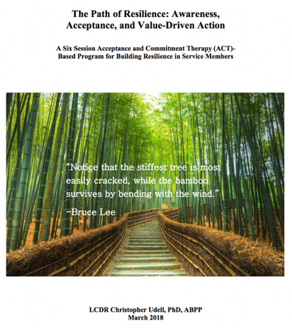
3d MLG Psychological Resilience Program
Acceptance and Commitment Therapy-based program written by LCDR Udell in March 2018
One cycle
Six classes, twice a week for three weeks
Most classes are 2 hours long
Modules：
ABC behavioral model, confronting emotional control
Mindfulness
Cognitive defusion
Self-as-observation, willingness
Value-driven action
ACT for increasing resilience

Slide 33
3d MLG Psychological Resilience Program
Still running cycles of groups; were on hold for several months due to COVID19 restrictions
Meet with company level officers and senior enlisted in order to promote the program and attract participation
Clearly lay out the potential benefits, including greater efficiency and productivity of personnel, improved teamwork and communication, reduction in alcohol misuse and suicidal behavior, and less absence from work for mental health treatment appointments
Run into challenges of platoons unwilling to allow personnel to be gone from work to attend the classes; misplaced expectations that people can be ‘fixed'

Slide 34
Garrison vs deployment/exercise
Garrison refers to military personnel at their assigned duty stations; where they are located when not on an exercise or deployment
Significantly more treatment is administered while in garrison compared to when on an exercise or deployment
Partly that’s because there are more treatment resources in garrison
However, military personnel also tend to be more emotionally healthy on exercises or deployments than when in garrison
Some personnel struggling with intense psychological issues, who have recently been psychiatrically hospitalized, who displayed marked behavioral problems may be restricted from exercises/deployments
Faster tempo, increased responsibilities, greater operational focus tends to be associated with better mental health

Slide 35
ACT for enhanced performance in combat settings
Expands the role of the mental health officer from the standard PIES model of identifying, treating, and dispositioning personnel to an emphasis on optimizing war fighting capabilities through empirically supported psychological resilience concepts and skills
ACT applications within fields of sports psychology and physical pain are especially relevant
Emphasis is on enhancing performance in operational tasks, many of which are specific to the member’s specialty occupation; but some operational tasks are the responsibility of all personnel

Slide 36
What do we mean by ‘operational task?’
By ‘operational task,’ I’m referring to one’s MOS/rate and military duties. However, ‘operational task’ really includes more than that, such as physical training, writing reports, listening to a training, attending meetings, etc. Because all of these ‘tasks’ or behaviors are relevant to combat readiness.
Conducting public affairs
Applying a tourniquet
Firing a weapon
Flying an aircraft
Attending training
Conducting training
Field artillery
Operating a 7-ton
Explosive ordinance disposal
Preparing and serving food
Providing medical services
Field day
Mentoring and disciplining
Drafting operating procedures
Tracking and organizing supplies
Running, weight lifting
Repairing a radio
Gathering intelligence
Air traffic control
Managing staffing

Slide 37
Why were Samurai Attracted to Zen?¹⁸
Reducing attachment to internal experiences (→ self-as-context)
Process-orientation enhances performance (→ values identification)
Staying in the present optimizes execution of training (→ getting present)
Emphasis on action rather than excessive thinking (→ cognitive defusion)
Physical and mental discipline (→ commitment)

Slide 38
Mindfulness in Military Operations
Passage from Marine Corps Warfighting：
“We should base our decisions on awareness rather than on mechanical habit. That is, we act on a keen appreciation for the essential factors that make each situation unique instead of from conditioned response.”

Slide 39
Navy SEALs and the Application of Mindfulness
Extensive interviews were conducted with 12 Navy SEALs to discover how they implement mindfulness on the battlefield¹⁹
Information from the interviews was aggregated and four main mindfulness components were identified:
Attention to discriminatory detail
Active engagement in the present
Flexible, open state of mind
Awareness of multiple emerging realities

Slide 40
A
Antecedent
B
Behavior
Stimulus
Response
Stimulus
Response
Space:
Mindfulness
Victor Frankl: Between stimulus and response there is a space. In that space is our power to choose our response. In our response lies our growth and our freedom.

Slide 41
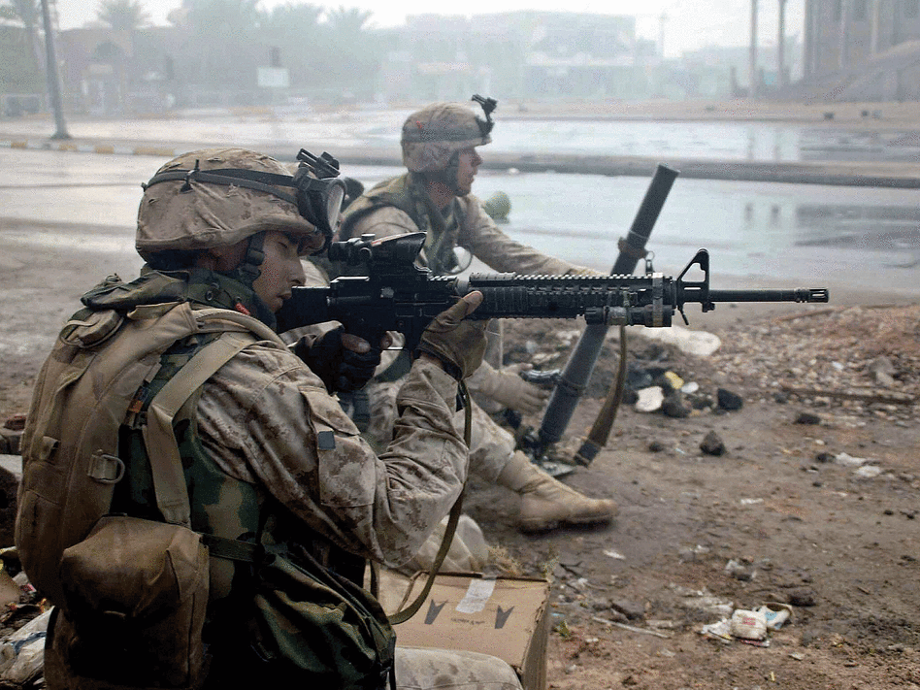
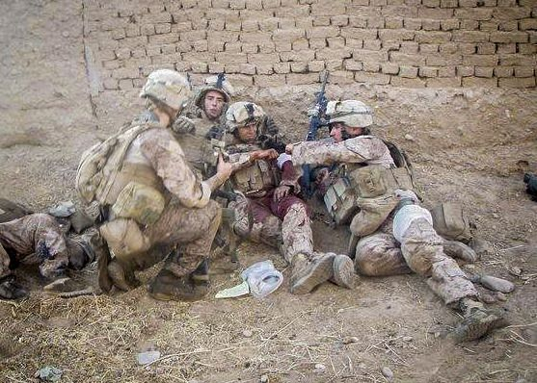
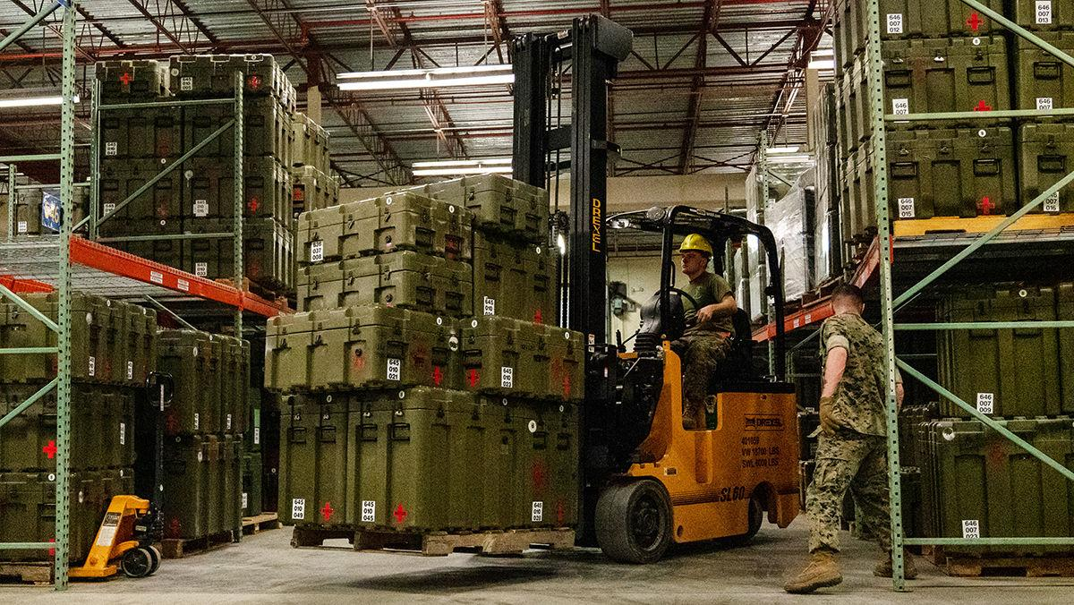
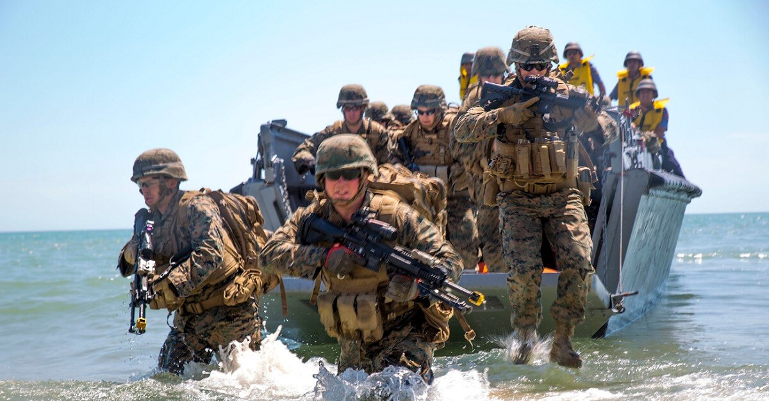
‘The space between stimulus and response‘

Slide 42
Mindfulness ＝ Psychological Armor²⁰
For U.S. service members, physical training is insufficient. Mindfulness is a kind of ‘psychological armor’ vital for preparing the mind for combat situations.
There is always a risk in battle to become distressed or rattled at times when effective decision making is needed most. Mindfulness trains service members to maintain flexible attentional control and centeredness in order to take necessary action.

Slide 43
﻿”We define mental toughness as the ability to act in a purposeful ﻿manner, systematically and consistently, in the pursuit of the values that underlie performance activities, even (and especially) when faced with strong emotions that we as humans naturally want to control, eliminate, or reduce.”¹¹
~ Frank Gardner & Zella Moore, authors of The Psychology of Enhancing Performance: The Mindfulness-Acceptance-Commitment (MAC) Approach

Slide 44
References
¹Jones, F.D. (1995). Psychiatric lessons of war. In Jones, F.D., Sparcino, L.R., Wilcox, V.L., Rothberg, J.M., & Stokes, J.W. (Eds.) War psychiatry: Textbook of military medicine (1-34). Washington, D.C.: Office of the Surgeon General, Borden Institute.
²Helmus, T.C. and Glenn, R.W. (2005). Steeling the mind: Combat stress reactions and their implications for urban warfare. Santa Monica, CA: RAND Corporation.
³Twenge, J.M. (2018). iGen : Why today's super-connected kids are growing up less rebellious, more tolerant, less happy - and completely unprepared for adulthood : And what that means for the rest of us. New York, NY: Atria Books.
⁴Lukianoff, G & Haidt, J. (2018). The coddling of the American mind: How good intentions and bad ideas are setting up a generation for failure. New York: Penguin Press.
⁵Arkin, M. A. Fewer Americans want to serve in the military. Cue pentagon panic. The Guardian. Retrieved from
https://www.theguardian.com/commentisfree/2019/apr/10/fewer-americans-serve-military-pentagon-panic
⁶Phillipps, D. (2018, September 21). As economy roars, Army falls thousands short of recruiting goals. The New York Times. Retrieved from
https://www.nytimes.com/2018/09/21/us/army-recruiting-shortage.html
⁷Spoehr, T. & Handy, B. (2018, February 13). The looming national security crisis: Young Americans unable to serve in the military. The Heritage Foundation. Retrieved from
https://www.heritage.org/defense/report/the-looming-national-security-crisis-young-americans-unable-serve-the-military

Slide 45
References
⁸Snow, S. (2018, November 2). The corps is finding new Marines despite recruiting challenges. Marine Times. Retrieved from
https://www.marinecorpstimes.com/news/your-marine-corps/2018/11/02/the-corps-is-finding-new-marines-despite-recruiting-challenges/
⁹Vanden Brook, T. (2018, April 26). Army issues waivers to more than 1,000 recruits for bipolar, depression, self-mutilation. USA Today. Retrieved from
https://www.usatoday.com/story/news/politics/2018/04/26/army-issues-waivers-1-000-recruits-history-bipolar-depression-self-mutilation/554917002/
¹⁰Hughes, L.S., Clark, J., Colclough, J.A., Dale, E., & McMillan, D. (2017). Acceptance and Commitment Therapy (ACT) for Chronic Pain: A Systematic Review and Meta-Analyses. The Clinical Journal of Pain, 33(6), 552-568.
¹¹Gardner, F. L. & Moore, Z. E. (2007). The psychology of enhancing human performance: The mindfulness-acceptance-commitment (MAC) approach. New York, NY: Springer Publishing Company.
¹²Kaufman, K. A., Glass, C., Pineau, T. R. (2018). Mindful sport performance enhancement: Mental training for athletes and coaches. Washington, DC: American Psychological Association.
¹³Hansen, J. & Haberl, P. (2020). Helping athletes be present when performing under pressure. In Henriksen, K., Hansen J., & Larsen, C. H. (Eds.) Mindfulness and acceptance in sport: How to help athletes perform and thrive under pressure (pp. 47-58). New York, NY: Routledge.

Slide 46
References
¹⁴ConstantRenewal (n.d.). Nick Saban: Do your job and trust the process. https://constantrenewal.com/nick-saban-the-process/
¹⁵Udell, C. J., Ruddy, J. L., & Procento, P. M. (2018). Effectiveness of acceptance and commitment therapy in increasing resilience and reducing attrition of injured US Navy recruits. Military Psychology, 183, 9/10, e603-e611.
¹⁶Kessler, R.C., Heeringa, S.H., Stein, M.B., Colpe, L. J., Fullerton, C.S., Hwang, I.,…Naifeh, J.A. (2014). Thirty-Day Prevalence of DSM-IV Mental Disorders Among Nondeployed Soldiers in the US Army. JAMA Psychiatry, 71(5), 504-513.
¹⁷Colpe, L. J., Naifeh, J. A., Aliaga, P. A., Sampson, N. A., Heeringa, S. G., Stein, M. B., …Kessler, R. C. (2015). Mental health treatment among soldiers with current mental disorders in the army study to assess risk and resilience in service members (Army STARRS). Military Medicine, 180(10), 1041-1051.
¹⁸Mann, J. K. (2012). When Buddhists attack. Tokyo, Japan: Tuttle Publishing.
¹⁹Fraher, A. L., Branicki, L. J., & Grint, K. (2017). Mindfulness in action: Discovering how U.S. Navy SEALs build capacity for mindfulness in high-reliability organizations (HROs). Academy of Management Discoveries, 3, 239-261.
²⁰Gelles, D. (2015). Mindful work: How meditation is changing business from the inside out. Boston: Houghton Mifflin Harcourt.

